Slide 1
Who was the ‘typical’ Australian in 2016? The ‘typical’ Australian is a 38 year old female. A decade ago, the ‘typical’ Australian would have been a year younger. In 1911 the ‘typical’ Aussie was a 24 year old male, but women have outnumbered men since 1979. The ‘typical’ Aboriginal and/or Torres Strait Islander person is also female, but she’s younger: 23 years old, in fact. The ‘typical’ Australian male or female was born in Australia, has English ancestry and parents also born in Australia. But while the ‘typical’ Australian has parents born in Australia, if you are from New South Wales, Victoria or Western Australia your actually most likely to have at least one parent who was born overseas. The ‘typical’ Aussie male is 37 years old and spends less than five hours a week on domestic work. The ‘typical’ Aussie female is 38 years old and spends between five and 14 hours a week on domestic work.
How do we know all this? Where does this information come from?
How can this information be used?

Slide 2
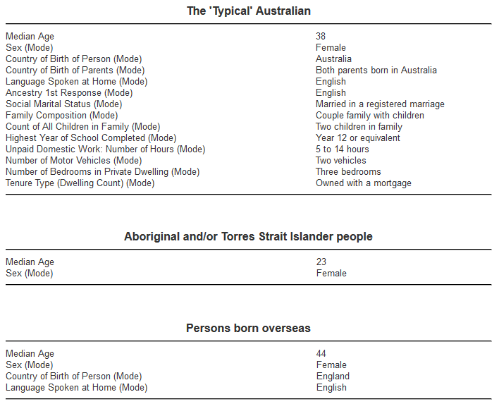
What are the 2 measures that were used to create this data?

Slide 3
Quick Write.
What do you think a Census is?
What are the advantages and disadvantages to a census?
What is the alternative?

Slide 4
24
7
30
Date
Topic: Data
EQ – How can you create a fair survey of a population.
In a census, everyone in a population is surveyed.
In a sample, only a section of the population is surveyed. The larger the sample size, the more accurate it is.
A census is more accurate but samples are quicker and cheaper.
Examples.
A survey of year 9 students is conducted and everyone is asked to respond is an example of a census of all year 9 students.
A phone survey is conducted where every 20th person is called is an example of a sample.

Slide 5
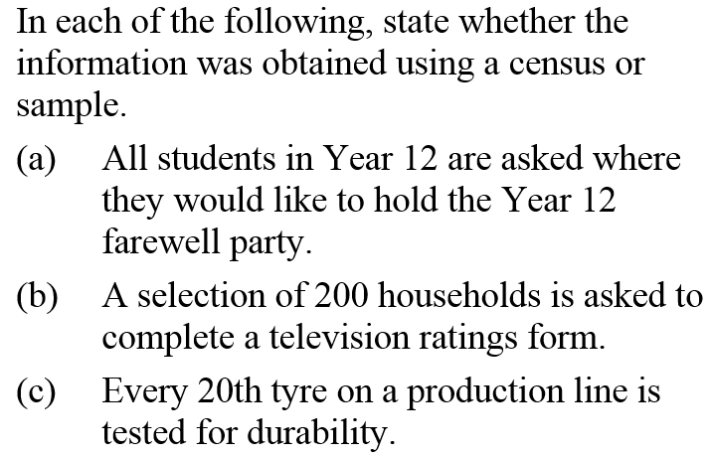
Example
a) Census b) Sample c) Sample

Slide 6
Now complete the Survey vs Census section of your worksheet.

Slide 7
What is wrong with the following surveys? Discuss with the person next you and be prepared to share your ideas.
A sample of 15 students concluded that all students like romantic comedies more than action movies.
A recent survey conducted at “Lakelands Retirement Centre” determined that “Antiques Roadshow” was Australia’s favourite tv show.
When asked if people would like to earn more money and if they were vegetarian, most replied “No”.
A survey asked the question. “Do you support the increasingly disliked and unrespected Prime minister?”

Slide 8
24
7
30
Topic: Data
Date
EQ – How can you create a fair survey of a population.
What is a Biased Survey?
A biased survey gets skewed results because of the design of the survey and its questions.
Leading Questions will sway your reader to a particular side.
Example: How dumb is (insert politician) when it comes to foreign policy?
Loaded Questions force people into answering the question in a particular way.
Example: Where do you like to party? Well, what if the respondents don’t like to party?
Double-Barreled Questions forces your respondents to answer two questions at once.
Example: How happy or unhappy are you with the rate of current school board funding and the common-core curriculum?
Absolute questions usually only have the option of a yes or no answer
Example : Do you always shower before bed?
The Unclear Question
Tech jargon and acronyms create bias if people don’t understand the jargon.

Slide 9
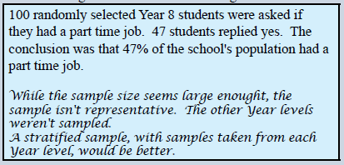
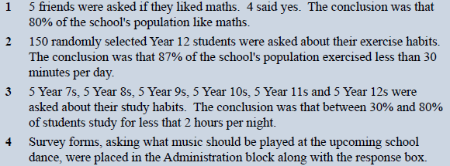
LETS GO THROUGH THESE TOGETHER.
Are these Biased? Why?

Slide 10
Now complete the rest of your worksheet.

